Slide 1
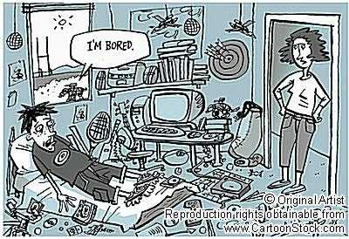

Slide 2
Dermot Shinners-Kennedy
CS-0210
e: Dermot.Shinners-Kennedy@ul.ie
t: 061-202767

Slide 3
Philosophy (0 of 32767)
My children have a curious way of asking me questions.
It usually goes something like this…
Dad – what time is it – and I don’t want to know how a clock works!
With that in mind I want to say a few words about my teaching philosophy…

Slide 4
Philosophy (1 of 32767)
University begins with yoU and ends in whY.
It’s NOT a competition.
It’s NOT about the university.
For learning to occur something dynamic must occur in the learner!
“I never teach my pupils; I only attempt to provide the conditions in which they can learn.” (Albert Einstein)
I don’t want to “teach you a lesson” – I want you to “learn stuff”.

Slide 5
Philosophy (2 of 32767)
You have come here to question, NOT to worship.
The only stupid question is the unasked one.
However, I would prefer to avoid questions like
  Can an atheist make an insurance claim on the basis of an act of God?
  or
  What happens if you get frightened half to death – twice?

Slide 6
Philosophy (3 of 32767)
Each of us has
  several billon brain cells
  two eyes
  two ears
  one mouth
Let’s try using those resources in proportion.

Slide 7
Philosophy (4 of 32767)
It ain’t what you don’t know that gets you into trouble
It’s what you know for sure that just ain’t so
Mark Twain

Slide 8
Philosophy (32767 of 32767)
This is YOUR learning experience.
My job is
to uncover the material (so you can see it, touch it, smell it, bite it, thump it, play with it, break it, fix it, use it, explore it, enjoy it)
not cover it (so that it is hidden).
I will follow a trusted path but it is not the only one.
Be inquisitive. Explore.
You know more than you think you do!
I don’t want you to think. I want you to reason.

Slide 9
JAVA
This module is NOT about learning a programming language
It is about learning the language of programming.
We are going to use JAVA as a vehicle for learning the language of programming.
We don’t just want to learn JAVA!

Slide 10
Classes and Objects
Class
  Blueprint or design or plan
  Describes something that can/could/might be created.
Object
  An instance (or instantiation) of a class
  Physically exists – can be manipulated
  Must be explicitly created

Slide 11
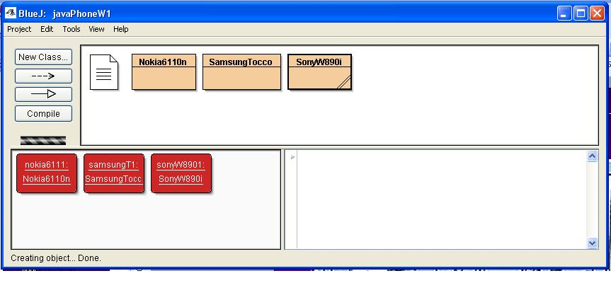
Classes and Objects

Slide 12
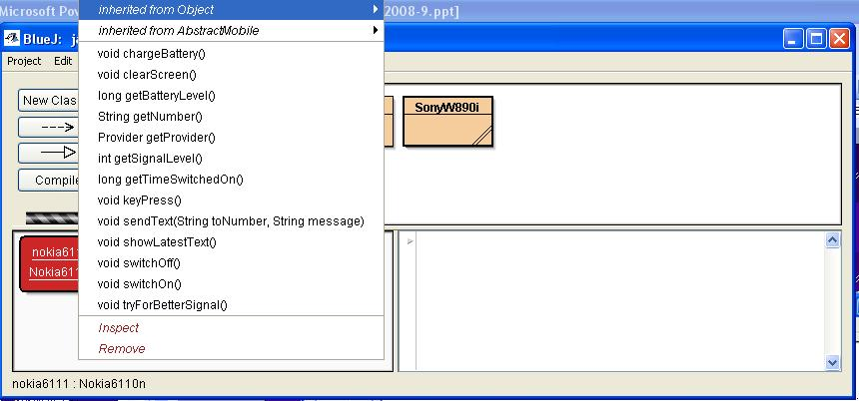
Objects - Behaviour

Slide 13
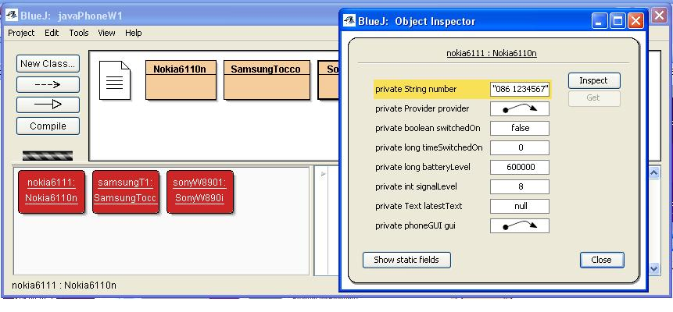
Objects - State

